Slide 1
Erasmus+
How to prepare your Erasmus Mundus Design Measures (EMDM) proposal
European Education and Culture Executive Agency

Slide 2
EMJM – How to apply
WHERE?
WHO?
WHEN?
Applications must be submitted through the European Commission's Funding & Tender Opportunities Portal (F&TP) using the Portal Submission System
Proposals must be created and submitted by a contact person of the applicant institution
Deadline: please refer to the Funding & Tender Opportunities Portal
Applicants are highly recommended to submit proposals as early as possible and at least 48 hours prior to the call deadline
!

Slide 3
Preliminary steps Preparation
1
Consult the How to find and apply for funding opportunities presentation
Get more guidance on how the Funding and Tender Opportunities portal works in the F&TP online manual and the Proposal Submission User Manual
2
Read carefully the information on the Roles and access rights and decide the persons who will manage the application
3

Slide 4
Get prepared
Read carefully all the call documents
Erasmus+ Programme Guide and proposal templates that can be found in the F&TP under the respective topic conditions and documents
!
Plan your project and define your work plan
Technical description, work package and deliverables
Create an EU Login account
To be able to submit a proposal, you must register on the Portal for an EU Login account
Make sure your organisation has a valid Participant Identification code (PIC). If not, get one!
Participant Register

Slide 5
Application requirements
Check the compliance of the proposal with the criteria of the Programme Guide in Part B (Erasmus Mundus Lot 2 – Design Measures) and Part C – Information for applicants.
ADMISSIBILITY CRITERIA
Submit the application electronically via the F&TP Electronic Submission System
Use the forms provided in the Submission System
Submit complete application containing all parts and mandatory annexes
Respect the page limit for Part B of the application form (40 pages)
4
Respect the deadline

Slide 6

Application requirements (cont.)
Check the compliance of the proposal with the criteria of the Erasmus+ Programme Guide:
Eligibility criteria
Applicants must be an eligible HEI, established in an EU Member State or third country associated to the Programme.
Applicants must hold a valid Erasmus Charter for Higher Education (ECHE).
Project duration: 15 months
Deadline for applications: please refer to the Funding & Tender Opportunities Portal
Exclusion and Selection criteria
Applicant is not in any of the exclusion situations described in Articles 136-141 of the Financial Regulation (Part C of the Erasmus + Programme Guide)
The applicants’ financial and operational capacity are adequate

Slide 7
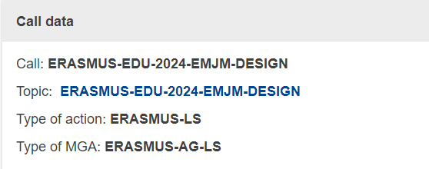

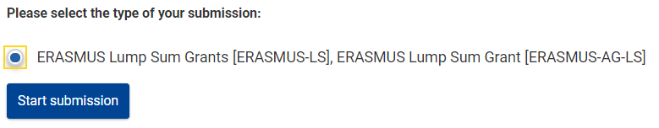
Get started
Log into the Funding and Tender Portal and select the correct topic.
Make sure you are in the correct Call for proposals and Type of action.
Access the electronic submission system:
You will need to use the online forms and templates available in the Submission System

Slide 8

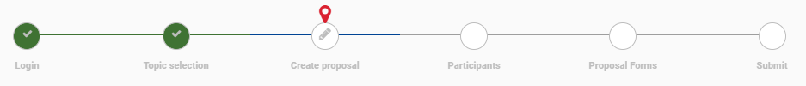
Get started (cont.)
In the step ‘Create proposal’ identify the applicant organisation PIC:
Select your role. At least one Main contact must be provided (refer to the Portal section Roles and access rights for more information).
Indicate the proposal acronym and enter a short summary. These will be displayed in the "General Information" section of the Application Form Part A, where it can still be changed.
It is not possible to add partners nor associated partners mono-beneficiary Grant Agreement (the applicant is the only beneficiary).
Other participating organisations are to be described in Part B of the application form
A progress bar on the top of the page indicates the proposal completion progress.

Slide 9
Application package
Complete Part A & C (KPI) directly on the Portal. Prepare Part B in advance and upload it together with the annexes
The application form is structured in three parts:
Part A – Administrative Forms
A
Contains general information about the project, data on the applicant organisation and contact persons
Part B – Technical description
B
Contains the narrative part of the project, the work package and deliverables
Part C (KPI)
C
Key performance indicators, statistical features related to planned objectives

Slide 10

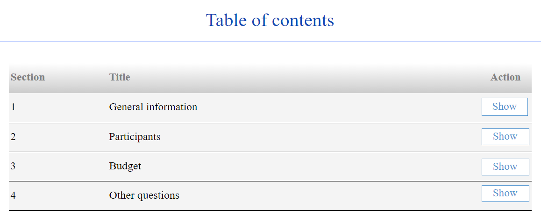


Part A – Administrative forms
Use the icon to access the administrative forms
Some data fields in the administrative forms are pre-filled based on the steps in the submission wizard.
Section 1 - General information about the project:
Enter information related to the title and language of the proposal
Project duration encode 15 months
Enter free keywords that are relevant to the scope of the proposal
Don’t forget to include the project scientific areas
Remember to & regularly !

Slide 11
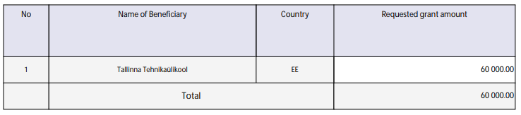
Part A – Administrative forms (cont.)
Section 1 - General information about the project (cont.):
Tick the relevant boxes under “Declarations”
Section 2 - Participants: provide information about the applicant organisation, the department(s) involved and contact persons
Section 3 - Budget: encode the fixed lump sum contribution of 60.000 EUR
Section 4 – Other questions: please enter and save the listed countries of your future partnership, including your own institution

Slide 12

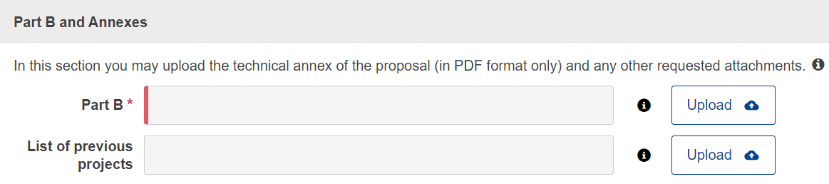
Part B – Technical description
Part B is the only mandatory annex:
Part B must be prepared in advance using the template downloaded from the system
It’s not required to add ‘Other annexes’

Slide 13
EMDM Part B – Technical description
The Application form contains the technical description of the project. It is a generic form for more actions, but applicants should base the information on the EMDM Award criteria as published in the Programme Guide.
It should be completed and uploaded in the F&T Portal in PDF format.
Follow the instructions provided in the application form and do not change the structure, titles or subtitles of the form.
Application Form structure:
Sections 1, 2 & 3 Award Criteria
Section 4 Plan, Work Package & Timing
Section 5 Not applicable for EMDM
Section 6 Declarations concerning double funding
Notes:
REDO

Slide 14
Part B – Technical description (cont.)
Sections 1-3 – For the following sections, please read the instructions carefully:
Section 1.2 Needs analysis and specific objectives - it is not necessary to describe a sound needs analysis nor to define indicators for measuring achievement. However, please address the specific award criteria as set out in the Erasmus+ Programme Guide, and the sub-criteria under “Relevance”
Section 2.1.2 Project management, quality assurance and monitoring and evaluation strategy - it is not necessary to describe evaluation methods and indicators to monitor the outreach and coverage. However, please address the specific conditions set out in the Programme Guide and the sub-criteria under “Quality of the project design and implementation”
Section 2.1.3 Project teams, staff and experts – please identify staff of the future consortium, but it is not necessary to provide the CVs
Section 2.1.4 Cost effectiveness and financial management - not applicable for EMDM projects
Section 2.1.5 Risk management – it is not necessary to present critical risks and risk management strategy for EMDM projects
Section 2.2.2 Consortium management and decision-making mechanisms - not applicable for EMDM projects

Slide 15
Part B – Technical description (cont.)
Section 4 - description of the work plan and of the project activities
Use one single work package to describe the planned activities ex. WP1 – “project acronym”
Show who is participating in each task; include the participating organisations
For EMDM it is not necessary to include milestones. The section on milestones can be left empty
To define the main deliverables use the list of EMDM expected outcomes/joint mechanisms that is listed in the Erasmus+ Programme Guide (please also consult the Q&As on the F&TP for the type of deliverables we expect to see).
We recommend using the dissemination level ‘SEN(sitive)’ for your deliverables. Note that “PUB(lic)” deliverables will be automatically displayed by the system on the due date that you indicated in the application.
When completing the Timetable keep in mind that the duration of an EMDM project is 15 months
Section 5 - not applicable for EMDM projects
Section 6 - please reply Yes or No concerning the Declarations on double funding

Slide 16
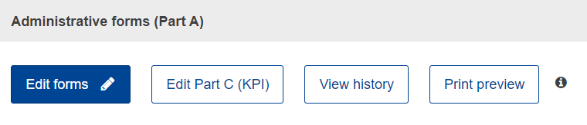
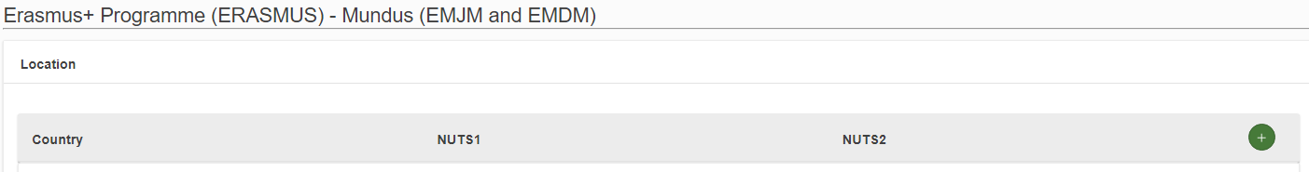
Part C (KPI) - Key Performance Indicators
On the top of the page, expand the table in order to select all countries of the partners of your future master programme (including the coordinator and the third country/ies not associated to the Programme):
Note that the form is shared with the EMJM action, so certain fields referring to EMJM do not apply to your EMDM proposal.
Complete all mandatory fields (marked with a *) and carefully read the help texts.
As for the mandatory numerical fields (under ‘output, result and impact indicators’), please refer to your planned indicators in so far as you know today.

Slide 17
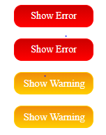
Validate & submit your proposal
Edit your draft proposal as many times as you need to complete/correct information
Run a validation of your draft proposal to make sure it meets the requirements and no information is missing
Errors and warnings will be listed at the end of the form
Errors mean that mandatory information is missing and the proposal cannot be submitted until they are corrected
Warning messages do not block submission, but they indicate missing information. Ideally, these should be addressed by correcting the information provided
After submission, you can still edit and update the proposal at any time before the deadline. However, if you change the content you will need to re-submit for the changes to be reflected
For more information consult the Proposal Submission User Manual

Slide 18
General advice When writing your proposal make sure it is:
SIMPLE & CONCRETE
Use examples, justify your statements, bring proofs
4
EXPLICIT
Do not take anything for granted; do not assume experts will always immediately understand; avoid or explain abbreviations
COHERENT
Avoid contradictions, avoid ‘patchwork’
3
5
!
COMPLETE
Ensure (twice!) you have followed all the instructions, and that the proposal fulfils all the mandatory requirements
RIGOROUS
The application is the basis on which your project will be implemented; it is also the cornerstone of your partnership commitment
2
Don’t forget to submit your application well in advance of the deadline!
6
CLEAR
Follow the questions and respond to the sub-points of the Award Criteria paying attention to the specific context
FOCUSED
Stick to what is asked. Respect the page limit for Part B
1
7

Slide 19

Other information sources
20 years of Erasmus Mundus - Beyond borders and boundaries and 20 years of Erasmus Mundus (key figures)
Erasmus Mundus 20th anniversary conference “Beyond borders and boundaries” - Conference report, 27-28 May 2024, Brussels
Erasmus Mundus, analysis of the results of the second 2021-2027 call (joint masters and design measures)
Erasmus Mundus, analysis of the results of the first 2021-2027 call (joint masters and design measures)
Statistical factsheets on the achievements of the Erasmus Mundus Joint Master Degrees (2014-2020)
Erasmus+ Factsheets
Report 'Implementing Joint Degrees in the Erasmus Mundus action of the Erasmus+ programme’
Erasmus Mundus Catalogue (europa.eu)
EMJMD Cluster meeting 2018: European Approach for Quality Assurance of Joint Programmes
and Follow-up event 2019 "Implementing the European Approach for Quality Assurance for EMJMDs
Erasmus Mundus Joint Master Degrees - The story so far
Sustainability of Erasmus Mundus Master Courses - Best practice guide
Erasmus+ Project result platform

Slide 20

Good luck !
Contact us at
EACEA-EPLUS-ERASMUS-MUNDUS@ec.europa.eu
F&TP Service Desk
EC-FUNDING-TENDER-SERVICE-DESK@ec.europa.eu
F&TP Service Desk
+32 2 29 92222
© European Union 2024
Unless otherwise noted the reuse of this presentation is authorised under the CC BY 4.0 license. For any use or reproduction of elements that are not owned by the EU, permission may need to be sought directly from the respective right holders.
Slide 1 Image, source: © European Union, 2024 (CC BY-NC-ND 4.0) — iStockphoto.com

