Slide 1
Erasmus+
How to prepare your Erasmus Mundus Joint Masters (EMJM) Proposal
European Education and Culture Executive Agency

Slide 2
EMJM – How to apply
WHERE?
WHO?
WHEN?
Applications must be submitted through the European Commission's Funding & Tender Opportunities Portal (F&TP) using the Portal Submission System
Proposals must be created and submitted by a contact person of the coordinating organisation
Deadline: please refer to the Funding & Tender Opportunities Portal
Applicants are highly recommended to submit proposals as early as possible and at least 48 hours prior to the call deadline
!

Slide 3
Preliminary steps Preparation
1
Consult the How to find and apply for funding opportunities presentation
Get more guidance on how the Funding and Tender Opportunities portal works in the F&TP online manual and the Proposal Submission User Manual
2
Read carefully the information on the Roles and access rights and decide the persons who will manage the application
3

Slide 4
Get prepared
Read carefully all the call documents
Erasmus+ Programme Guide and proposal templates that can be found in the F&TP under the respective topic conditions and documents
!
Plan your project and define your work plan
Technical description, work packages, milestones and deliverables
Create an EU Login account
To be able to submit a proposal, you must register on the Portal for an EU Login account
Make sure your organisation has a valid Participant Identification code (PIC). If not, get one!
Participant Register

Slide 5
Application requirements
Check the compliance of the proposal with the criteria of the Programme Guide in Part B (Erasmus Mundus Action Lot 1) and Part C – Information for applicants.
ADMISSIBILITY CRITERIA
Submit the application electronically via the F&TP Electronic Submission System
Use the forms provided in the Submission System
Submit complete application containing all parts and mandatory annexes
Respect the page limit for Part B of the application form (70 pages)
4
Respect the deadline

Slide 6

Application requirements (cont.)
Check the compliance of the proposal with the criteria of the Programme
Eligibility Criteria (1)
Applicants (coordinators and full partners) are any eligible participating HEI established in an EU Member State or third country associated to the Programme or in a third country not associated to the Programme (consult the The Erasmus+ Programme Guide for any restrictions)
Associations or organisations of HEIs, public or private organisations (including their affiliated entities) that contribute directly and actively to the delivery of EMJM established in an EU Member State, third country associated to the Programme or in an eligible third country not associated to the Programme, may also participate but not as coordinator
HEIs established in an EU Member State or third country associated to the Programme must hold a valid Erasmus Charter for Higher Education (ECHE)
Full HEI partners have fulfilled the external Quality Assurance requirements of their jurisdiction for the joint programme
Minimum Consortium: 3 full partner HEIs from 3 different countries, at least 2 EU Member States or third countries associated to the Programme

Slide 7
Application requirements (cont.)
Check the compliance of the proposal with the criteria of the Programme
Eligibility Criteria (2)
EMJM involves a compulsory physical student mobility of at least 2 study periods in 2 countries (of which at least one EU Member State or third country associated to the Programme and both different from the country of residence of students at enrollment stage).
Eligible duration: the consortium will receive a grant agreement for a duration of 74 months to finance at least 4 editions of the EMJM
Deadline for applications: please refer to the Funding & Tender Opportunities Portal
Exclusion and Selection Criteria
Applicant is not in any of the exclusion situations described in Articles 136-141 of the Financial Regulation (Part C of the Erasmus + Programme Guide)
The applicants’ financial and operational capacity are adequate

Slide 8
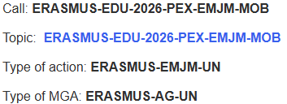
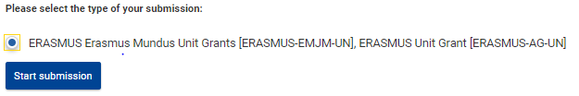


Get started
Log into the Funding & Tenders Portal and select your topic.
Make sure you are in the correct Call for proposals and Type of action.
Scroll down on the Call for Proposals page to get access to the Electronic Submission Service
Familiarise yourself with the Portal navigation system. You can edit information and move between parts of the form

Slide 9
Application package
Complete Part A & C (KPI) directly on the Portal. Prepare Part B in advance and upload it together with the annexes
The application form is structured in three parts:
Part A – Administrative Forms
A
Contains general information about the project, data on the applicant organisation and contact persons
Part B – Technical description & annexes
B
Contains the narrative part of the project, the work packages, milestones and deliverables
Part C – Key Performance Indicators (KPI)
C
Specificities about EMJM/EMDM (nº of ECTS, accreditation, type of degrees to be awarded, etc.)

Slide 10
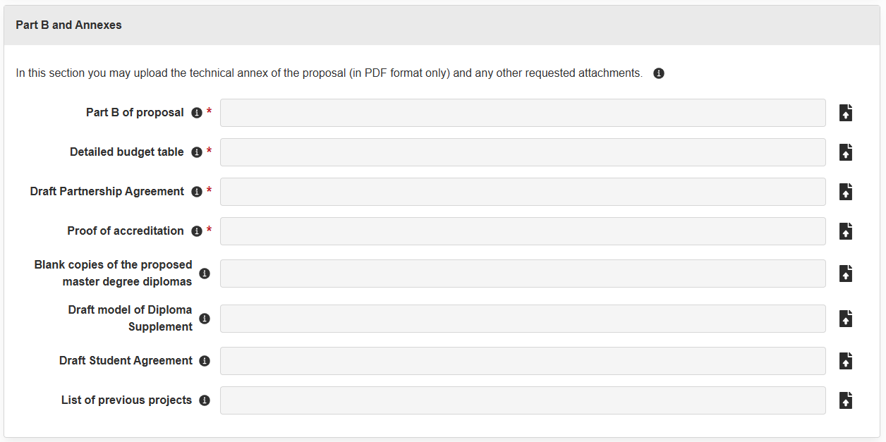
EMJM Application package Part B and annexes
Mandatory documents
Part B
Calculator (budget table)
Proof of accreditation
Draft Partnership Agreement
Optional annexes
Draft model Diploma Supplement
Draft Student Agreement
Copies of the proposed degree
List of previous projects

Slide 11
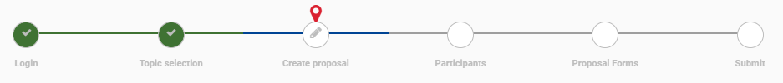


Part A - Create proposal
A progress bar on the top of the page indicates the proposal completion process
Throughout the eForm the fields marked with the red line are mandatory
In the step ‘Create proposal’ you need to identify the applicant organisation (PIC) and indicate the acronym and summary of the proposal.
Remember to & regularly!!

Slide 12

Part A - Participants
Start from the part ‘Participants’ where you can encode the full partners, the associated partners and their affiliated entities, if any.
Search by PIC number, add the participating organisation and the main contact person.
Once the partner is created use the button to assign as many roles as needed for the specific partner and complete further information (department, address etc.).
Repeat this process for all full and associated partners of the proposal.
At least one Main Contact must be provided for each partner except for the associated partners. Failure to do so will block the submission at the final step. Consult the presentations on the Proposal Submission User Manual and the Roles and access rights.
Only the Proposal Coordinator or another user with full access rights can grant full access to a Contact person.

Slide 13
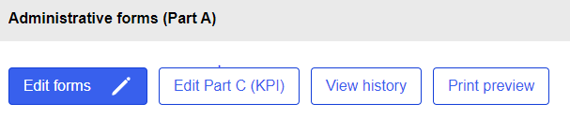
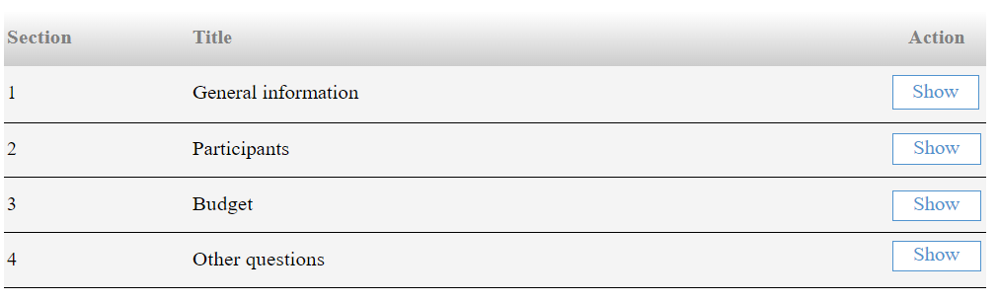
Part A - Administrative forms
Use the icon ‘Edit forms’ to access the administrative forms.
Here you can edit the following data.
Use the navigation bar to move between the 3 Sections. To exit this section click on ‘Save & exit form’.

Slide 14




Part A – General information
Section 1 ‘General information’
In this section you can edit information related to the title and language of the proposal
Indicate the project duration (74 months). Minimum 4 editions must be implemented
Enter free keywords that are relevant to the scope of the proposal
You can select only one main scientific area. To do so, use the drop-down menu ( )
You can select up to two sub-areas ( and )
One sub-area will appear by default. To add the second one click the button
While the first sub-area is linked to the main scientific area of your choice, the second sub-area can belong to a different main scientific area (interdisciplinarity).
Tick the relevant box(es) of the Declaration part at the end of the section

Slide 15
Part A – Participants & Budget
Section 2 ‘Participants’
In this section you can edit information related to the Participating Organisations and the key staff linked to the proposal
We advise you to provide as much information as possible
Section 3 ‘Budget’
Fill in the requested fields. The total amounts are automatically calculated.
The Requested Grant amount should correspond to the Total estimated EU contributions.
Use the navigation bar to move to the other Parts of the eForm.
Section 4 ‘Other questions’
Open this section, click on validate and subsequently on ‘save’ (no information needed)

Slide 16
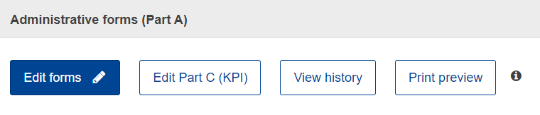
Part C – Key performance indicators (KPI)
On the top of the page, expand the table in order to fill out the form
Complete all mandatory fields (marked with a *) and carefully read the help texts
Note that certain fields do not need to be filled at this stage
Important fields to be completed: n. of ECTS, former EMJMD, former EMDM
As for the mandatory numerical fields (under ‘output, result and impact indicators’), please refer to your planned indicators in so far as you know today.

Slide 17
Part C – (KPI): Guidance & tips
Indicators to be provided in your application
N. of ECTS, former EMJMD, former EMDM: important information to be provided
Location - select countries covered by your partners (coordinator, full partners, associated partners)
Type of project, thematic areas and types of activities, type of master programme
Type of mobility activities
Contribution to any of the EU Commission political priorities - complete based on your current knowledge and planning in the proposal
Output, result and impact indicators, Policy impact - refer to your planned indicators objectives. Discard impact on the higher education (HE)
Third countries involvement information - (E+ not associated countries) - refer to your planned indicators objectives.
Courses, study programmes, research partnerships, publications, education projects - refer to your planned objectives
‘Accreditation/External evaluation data of EMJM national components’ - expand the table in order to fill in the features of the proposal
Note that the eForm proposes two sets of fields enabling you to input information about two different degrees. Only one set of fields of degree data is mandatory. The second option was made available for applicants that have more than one accredited degree in place (e.g. both at national level and at the level of the joint programme).
Enter your preferred starting date for the project, taking into account the starting date of your activities/expenses and the enrolment of the first generation of students (that should not start studying later than the academic year following the year of project selection).
‘Types of HEIs’ - expand the table in order to see and select all relevant categories.
and exit Part C by closing the window.

Slide 18
Part C – (KPI): Guidance and tips (cont.)
Indicators not to be provided in your application
Output, result and impact indicators, Policy impact
(impact on the higher education (HE) sector not necessary at this stage)
Socio-economic benefits
Investments
(for final report - enter “0”)
Persons reached
.

Slide 19
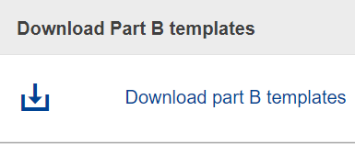

Part B – Technical description & Annexes
You can access Part B on the left side of your screen.
There are 3 templates provided for the mandatory documents (4 in total). Download and use them.
Technical description
Detailed budget table and calculator
Proof of Accreditation
Note that a draft Partnership Agreement must be provided at application stage as part of the mandatory annexes. Mandates and DoH are not requested at application stage.

Slide 20
EMJM Part B – Technical description
The Application form contains the technical description of the project based on the Programme Guide Award criteria.
It should be completed and uploaded in the F&T Portal in PDF format.
Follow the instructions provided in the application form and do not change the structure, titles or subtitles of the form.
Application Form structure:
Sections 1, 2 & 3 Award Criteria
Section 4 Plan, Work Packages & Timing
Section 5 This section is not applicable for EMJM
Section 6 Declarations concerning double funding

Slide 21
Part B – Technical description (cont.)
Award criteria – Tips and clarifications
Respond to all questions and sub-questions in Part B
Section 2.1.3 Outside resources
This section, common to many programmes, is about the subcontracted parts of your project if any. In the framework of EMJM, you can use this section to explain the insurance schemes for the students, for example. The intention of this field is not to explain the involvement of the associated partners to the joint programme. The information contained in this section will be mainly used for statistical purposes/information.
Section Events and Trainings
Use this field to describe the project’s main events and main Consortium meetings such as e.g. trainings for staff or summer events. Regular management meetings are not concerned. The content of the curriculum should be detailed under the relevant award criterion.
List of previous projects
This is at the end of Part B. Please refer only to a maximum of 5-6 main projects related to your field of study and/or to Erasmus Mundus. If you wish to add a more exhaustive list of international projects please use the section ‘Other annex’.

Slide 22
Part B – Technical description (cont.)
Work Packages – Tips and clarifications
The information on this section concerns the detailed description of the project activities and is complementary to the narrative parts of the application form. A work package means a major sub-division of the project. The work packages refer to and should be aligned with the award criteria. In a work package, the information on your project should be structured along expected outcomes, milestones and deliverables. The grouping of the activities should be logical and guided by identifiable outputs.
EMJM proposals should have 2 fixed work packages
Management and implementation of the Master programme
Selection and supervision of students
To insert Work Package 2 copy the tables provided for WP1.

Slide 23
Part B – Technical description (cont.)
Work Packages – Tips and clarifications
The number of milestones is free, but we advise you to limit this to the most important moments in your project.
The number of deliverables is free. However, please limit them to maximum 15 and to group activities, to facilitate contracting and management if your application is selected. For the type of deliverables we expect to see, please check the Erasmus+ Programme Guide or FAQs on the F&TP.
Please do not yet add any deliverable linked to progress or final / financial reports (to EACEA) in your application.
We recommend using the dissemination level ‘SEN(sitive)’ for your deliverables. Note that “PUB(lic)” deliverables will be automatically displayed by the system on the due date that you indicated in the application.

Slide 24
Part B – Proof of Accreditation
The Proof of accreditation template should be completed and signed by each full partner Higher Education Institution from an EU Member State or third country associated to the Programme or third country not associated to the Programme. The completed declarations and the supporting documents (proof of valid accreditation) of all full partner Higher Education Institutions should be merged into one file and uploaded in the Portal in PDF format.
There is the possibility of declaring a second accredited degree only if deemed necessary by the Higher Education Institution concerned (e.g. if in addition to the accredited national component there is also an accredited joint degree).
Insert additional accreditation declarations by copying the section ‘List of degree(s)’ for any other EMJM degree awarded per institution within the respective proposal. Repeating this section allows institutions that award more than one degree (e.g. depending on the study track) to provide proof of accreditation for each of those degrees.

Slide 25
Part B – Proof of Accreditation (cont.)
Please note that the list of degrees concerns only the current EMJM application. Do not include information about the accreditation of degrees related to other EMJM applications you institution(s) might be involved in.
Highlight the relevant passages (core references/text certifying the accreditation/evaluation validity) in the supporting documents. In addition, supporting documents which are not in one of the official EU languages should be accompanied by a translation in English of the core passages.

Slide 26
Part B – Detailed budget table and calculator
The Detailed budget table and calculator is an excel file that calculates the Erasmus Mundus Joint Master’s requested grant automatically.
The first worksheet contains detailed instructions on how to use the calculator.
Only the blue fields on the upper part of the calculator should be completed (worksheet 2).
An error message appears when the numbers of scholarships encoded are superior to the maximum numbers allowed per budget Heading.
The numbers entered in the calculator are translated automatically into Unit contributions in the Detailed budget table (worksheet 3).
Make sure to use the version of the ‘calculator’ from the 2026 application form (max. number of NDICI scholarships 18; max. number of IPA III scholarships 2)

Slide 27
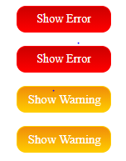
Validate & submit your proposal
Edit your draft proposal as many times as you need to complete/correct information
Run a validation of your draft proposal to make sure it meets the requirements and no information is missing
Errors and warnings will be listed at the end of the form
Errors mean that mandatory information is missing and the proposal cannot be submitted until they are corrected
Warning messages do not block submission, but they indicate missing information. Ideally, these should be addressed by correcting the information provided
After submission, you can still edit and update the proposal at any time before the deadline. However, if you change the content you will need to re-submit for the changes to be reflected
For more information consult the Proposal Submission User Manual

Slide 28
General advice When writing your proposal make sure it is:
SIMPLE & CONCRETE
Use examples, justify your statements, bring proofs
4
EXPLICIT
Do not take anything for granted; do not assume experts will always immediately understand; avoid or explain abbreviations
COHERENT
Avoid contradictions, avoid ‘patchwork’
3
5
!
COMPLETE
Ensure (twice!) you have followed all the instructions, and that the proposal fulfils all the mandatory requirements
RIGOROUS
The application is the basis on which your project will be implemented; it is also the cornerstone of your partnership commitment
2
Don’t forget to submit your application well in advance of the deadline!
6
CLEAR
Follow the questions and respond to the sub-points of the Award Criteria paying attention to the specific context
FOCUSED
Stick to what is asked. Respect the page limit for Part B
1
7

Slide 29

Other information sources
20 years of Erasmus Mundus - Beyond borders and boundaries and 20 years of Erasmus Mundus (key figures)
Erasmus Mundus 20th anniversary conference “Beyond borders and boundaries” - Conference report, 27-28 May 2024, Brussels
Erasmus Mundus, analysis of the results of the second 2021-2027 call (joint masters and design measures)
Erasmus Mundus, analysis of the results of the first 2021-2027 call (joint masters and design measures)
Statistical factsheets on the achievements of the Erasmus Mundus Joint Master Degrees (2014-2020)
Erasmus+ Factsheets
Report 'Implementing Joint Degrees in the Erasmus Mundus action of the Erasmus+ programme’
Erasmus Mundus Catalogue (europa.eu)
EMJMD Cluster meeting 2018: European Approach for Quality Assurance of Joint Programmes
and Follow-up event 2019 "Implementing the European Approach for Quality Assurance for EMJMDs
Erasmus Mundus Joint Master Degrees - The story so far
Sustainability of Erasmus Mundus Master Courses - Best practice guide
Erasmus+ Project result platform

Slide 30

Good luck !
Contact us at
EACEA-EPLUS-ERASMUS-MUNDUS@ec.europa.eu
F&TP Service Desk
EC-FUNDING-TENDER-SERVICE-DESK@ec.europa.eu
F&TP Service Desk
+32 2 29 92222
© European Union 2025
Unless otherwise noted the reuse of this presentation is authorised under the CC BY 4.0 license. For any use or reproduction of elements that are not owned by the EU, permission may need to be sought directly from the respective right holders.
Slide 1 Image, source: © European Union, 2024 (CC BY-NC-ND 4.0) — iStockphoto.com

